Slide 1

Review focus
PAPER PRESENTATION · ICSME 2021
• What problem does the paper address?
• What are the four architecture challenges?
• How do they appear in practice?
• What kind of evidence supports the claims?
Software Architecture
Challenges for ML Systems
Grace A. Lewis · Ipek Ozkaya · Xiwei Xu
Carnegie Mellon Software Engineering Institute · CSIRO Data61 and UNSW
Architecture for systems that use ML — not the architecture of the ML algorithm itself.
Presented by: Maryam Hanif and Hani Abushark
Maryam Hanif & Hani Abushark · Software Architecture Challenges for ML Systems
Paper Review
1 / 14

Slide 2
PROBLEM STATEMENT
What kind of problem is this paper addressing?
A software architecture problem for systems that use ML — not a paper about a new ML algorithm.
Core problem
Once an ML model is placed inside a real software system, traditional architecture is not enough because model behavior depends on data, training, parameters, and real-world change.
Why this is different from normal software
Simple production example
• Normal software mainly follows rules written in code.
• ML software also learns behavior from training data.
• If the real world changes, predictions may become unreliable even without a code change.
• A fraud-detection model is 92% accurate in the lab.
• Later, fraud patterns change. Servers, APIs, and database are still OK.
• Accuracy drops, so the architecture must monitor, retrain, and trace versions.
Audience takeaway: the paper is about engineering complete ML-enabled systems so they keep working after deployment.
Maryam Hanif & Hani Abushark · Software Architecture Challenges for ML Systems
Paper Review
2 / 14

Slide 3
BACKGROUND & MOTIVATION
The problem: a model is not a system
The paper argues that production ML needs architecture thinking, not only model development.
Core problem
A real ML-enabled system depends on
Most attention goes to building and evaluating the model. Less attention goes to putting the model into production, monitoring it, and evolving it over time.
Data pipeline
Software components
Deployment
Infrastructure
Simple example
Monitoring
Governance
A fraud model can be accurate in the lab, but in production it also needs data pipelines, APIs, deployment, logging, governance, and retraining.
Key idea: the model is only one component inside a larger software architecture.
Source: Lewis, Ozkaya & Xu (2021), abstract and introduction.
Maryam Hanif & Hani Abushark · Software Architecture Challenges for ML Systems
Paper Review
3 / 14

Slide 4
TRADITIONAL SOFTWARE VS ML SYSTEMS
Why ML changes architecture assumptions
Traditional software follows programmed rules; ML behavior also depends on data.
Traditional software
Machine-learning systems
Rules are written directly in code.
Behavior follows programmed logic.
Changing code usually changes system behavior.
Behavior is learned from training data.
Outputs can be probabilistic.
Changing data can affect predictions without any code change.
KEY MESSAGE
ML behavior depends on code, the model, and the data.
Source: paper discussion of data-dependent ML component behavior.
Maryam Hanif & Hani Abushark · Software Architecture Challenges for ML Systems
Paper Review
4 / 14

Slide 5
THE ML MODEL LIFECYCLE
Deployment is not the end
Monitoring and maintenance are part of the lifecycle, not optional add-ons.
1
2
3
4
5
6
7
Model
requirements
Data
preparation
Feature
engineering
Model
training
Model
evaluation
Model
deployment
Model
monitoring
8
Maintenance
& evolution
What architecture must support
Collect runtime logs, metrics, feedback, and ground truth; detect drift; retrain or revisit model requirements.
Source: paper Figure 1, adapted from Amershi et al.
Maryam Hanif & Hani Abushark · Software Architecture Challenges for ML Systems
Paper Review
5 / 14

Slide 6
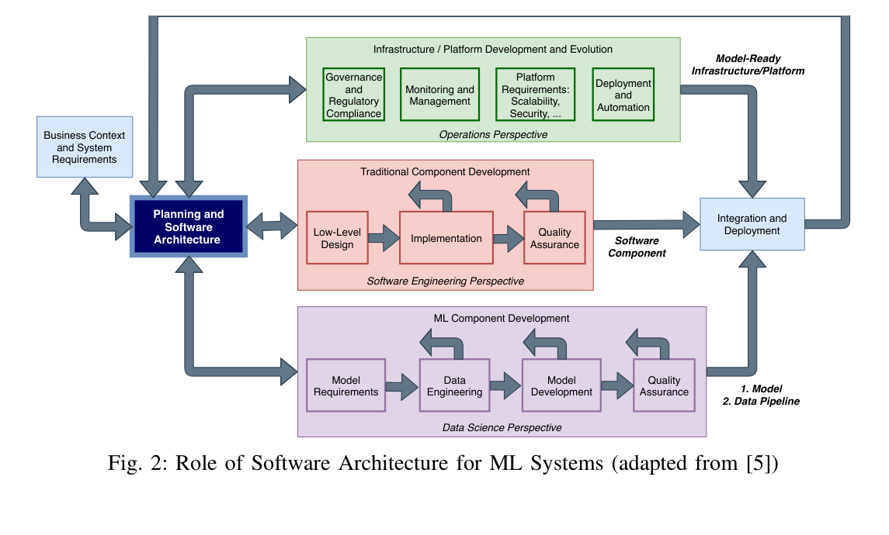
ORIGINAL PAPER FIGURE
Figure 2: Role of software architecture for ML systems
This is the paper’s central architecture view.
1 · Three development streams
Traditional software, ML components, and infrastructure/platform development must be designed together.
2 · Central coordination
Planning and software architecture connect data science, software engineering, and operations.
3 · Production readiness
Deployment brings together model, data pipeline, software component, platform, governance, and monitoring.
Use this slide to show the original contribution before simplifying it.
Source: Lewis, Ozkaya & Xu (2021), Figure 2.
Maryam Hanif & Hani Abushark · Software Architecture Challenges for ML Systems
Paper Review
6 / 14

Slide 7
FIGURE 2 SIMPLIFIED
Software architecture connects three communities
The simplified version of Figure 2 for discussion.
Software Engineering
Data Science
Operations
Design
Implementation
Testing
Data
Models
Evaluation
Deployment
Monitoring
Governance
Software Architecture
Production-ready ML system
Interpretation of the paper’s Figure 2.
Maryam Hanif & Hani Abushark · Software Architecture Challenges for ML Systems
Paper Review
7 / 14

Slide 8
FOUR ARCHITECTURE CHALLENGES
The paper organizes the gap into four challenge areas
The next slides explain each challenge with: meaning → practical example → what the paper suggests.
01
Architecture practices
02
ML quality attributes
Adapt existing practices to ML’s experimental and data-dependent development.
Develop patterns and tactics for explainability, fairness, privacy, data quality, and more.
03
Monitorability
04
Co-architecting & co-versioning
Treat continuous monitoring as a core architecture requirement.
Evolve application, model pipeline, data, and versions together.
The next four slides add practical examples for each challenge.
Source: paper Section III.
Maryam Hanif & Hani Abushark · Software Architecture Challenges for ML Systems
Paper Review
8 / 14

Slide 9
CHALLENGE 1 · ARCHITECTURE PRACTICES
Challenge 1: Architecture practices
Existing architecture and agile practices need adjustment because ML work is data-dependent and experimental.
What the challenge means
Practical example: student-risk model
• Traditional software behavior is mainly defined by code.
• ML behavior also depends on training data, features, and evaluation choices.
• Architecture must now include data quality, model accuracy, interpretability, and retraining.
• ML experiments make sprint boundaries and “done” criteria harder to define.
Sprint goal: “predict students at risk of failing.”
• Random Forest → 78%
• XGBoost → 82%
• New features → 86%
Question: is the work done, or should the team keep experimenting?
Source: paper discussion of architecture practices and sprint boundaries.
PAPER SUGGESTS
Adapt existing architecture and agile practices so they explicitly handle data quality, model uncertainty, experimentation, retraining, and changing “done” criteria.
Maryam Hanif & Hani Abushark · Software Architecture Challenges for ML Systems
Paper Review
9 / 14

Slide 10
CHALLENGE 2 · ML QUALITY ATTRIBUTES
Challenge 2: ML quality attributes
Accuracy is only one metric; trustworthy ML systems need additional quality attributes designed into the architecture.
What the challenge means
Practical example: bank loan approval
• Architecture is driven by quality attributes, not only features.
• In ML, accuracy alone is not enough to judge the system.
• Important attributes include explainability, data quality, fairness, privacy, security, and monitorability.
• The gap: we still need proven architectural patterns and tactics for these ML-specific qualities.
The model reports high accuracy, but the system may still be unacceptable.
Accuracy
94%
Looks strong
Fairness
?
May reject one group more
Explainability
?
Customer needs a reason
Privacy
?
Sensitive financial data
Source: paper discussion of ML-important quality attributes.
PAPER SUGGESTS
Develop and validate architecture patterns/tactics for ML-specific qualities: explainability, data quality, fairness, privacy, monitorability, and fault tolerance.
Maryam Hanif & Hani Abushark · Software Architecture Challenges for ML Systems
Paper Review
10 / 14

Slide 11
CHALLENGE 3 · MONITORABILITY
Challenge 3: Monitorability
The system may be technically healthy while the ML model quietly becomes unreliable.
What must be monitored
Practical example: fraud detection
• Software quality: server, API, database, latency, errors.
• Data quality: missing values, schema changes, new distributions.
• Model quality: accuracy, drift, calibration, false positives/negatives.
• Service quality: whether users still receive reliable decisions.
A new scam appears. The application still runs, but the model misses many fraud cases.
Server
OK
Model quality
API
OK
92% → 74%
Database
OK
drift
Infrastructure
OK
The alert should come from model/data monitoring, not only server monitoring.
Source: paper discussion of monitorability as a driving quality attribute.
PAPER SUGGESTS
Design monitoring components into the architecture from the start: monitor data quality, model quality, software quality, and service quality, then connect alerts to retraining/adaptation.
Maryam Hanif & Hani Abushark · Software Architecture Challenges for ML Systems
Paper Review
11 / 14

Slide 12
CHALLENGE 4 · CO-ARCHITECTING & CO-VERSIONING
Challenge 4: Co-architecting and co-versioning
The application architecture and the model-development pipeline must be designed and versioned together.
Co-architecting: design together
Co-versioning: trace everything
• Architecture A: the ML-enabled application used by people.
• Architecture B: the pipeline that creates the model from data.
• Both must evolve together: data, features, model, API, deployment, monitoring.
• Example: if the app changes input format, the model pipeline may need new preprocessing and tests.
If Model v12 gives bad predictions, the team must reproduce exactly how it was created.
Application
Training data
Features
v9
v7
v4
Parameters
Evaluation data
Model
v3
v5
v12
Traceability makes troubleshooting, auditing, and safe retraining possible.
Source: paper discussion of co-architecting and co-versioning.
PAPER SUGGESTS
Co-architect the application and model-development pipeline, and co-version the application, data, features, parameters, evaluation results, and deployed model together.
Maryam Hanif & Hani Abushark · Software Architecture Challenges for ML Systems
Paper Review
12 / 14

Slide 13
EVIDENCE · CONTRIBUTION · SOLUTION STATUS
This is a challenge paper, not a complete solution paper
It identifies problems and suggests research/practice directions, but does not validate a finished framework.
What the paper does NOT provide
What the paper DOES provide
No dataset experiment
No new ML algorithm
No accuracy/AUC comparison
No statistical testing
No controlled evaluation of one architecture
Qualitative evidence from targeted workshops, practitioner interviews, industry engagements, and an ICSA 2021 working session.
It organizes the problems into four architecture challenge areas.
Solution status: the paper proposes directions to be developed and empirically validated; it does not present a complete tested architecture solution.
Source: paper abstract, introduction, and conclusion.
Maryam Hanif & Hani Abushark · Software Architecture Challenges for ML Systems
Paper Review
13 / 14

Slide 14
Questions?
Thank you
Maryam Hanif and Hani Abushark
Maryam Hanif & Hani Abushark · Software Architecture Challenges for ML Systems
Paper Review
14 / 14

